Slide 1
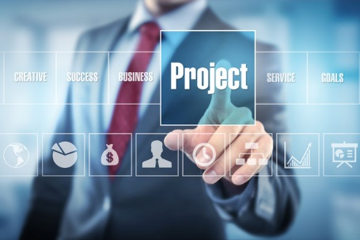
Primary Contact Workshop-4
Team Members
Niharika Nallappagari
Spandana Chava
Suprem Raju Manthena
Prasunjit Nayak
Krishna Kumar Painuly
Rakshith Anand
Vamshinath Nallamothu

Slide 2
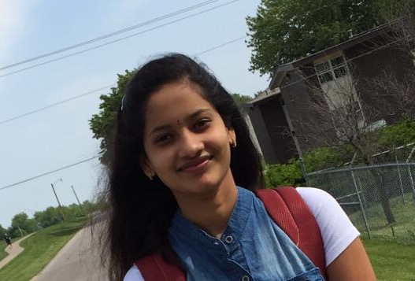

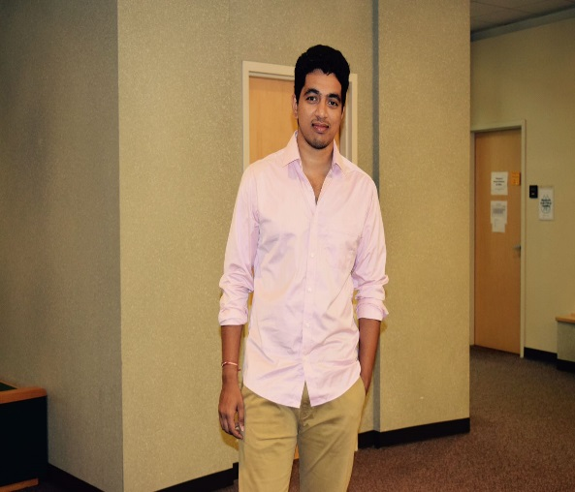
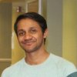
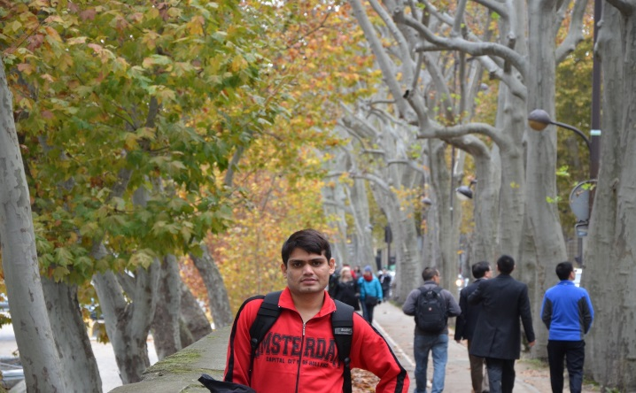


Team members
Niharika Nallappagari
Spandana Chava
Suprem Raju Manthena
Prasunjit Nayak
Krishna Kumar Painuly
Rakshith Anand
Vamshinath Nallamothu

Slide 3
Overview
Non-Functional Requirements
How to Document? User Interface design
Rest web services
How do you keep making process until things become available?
What do your front-end consumers of the services need to know about good design and practices?
How did we work together?
Bad/Good design

Slide 4

Reliability
Same results- Repeated Trails
Our trust on the system mostly depends on reliability of system.
Ex:- Student test results.
Reliability is of 2 types:
Internal reliability
External reliability
Errors with measurement:
Knowledge of User
Designer recklessness
Niharika Nallappagari

Slide 5
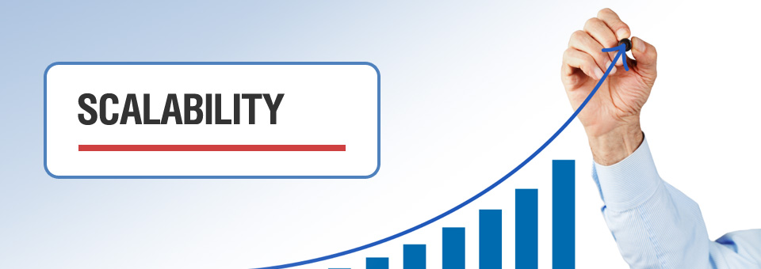
Scalability
Whether it can resist to changes.
Niharika Nallappagari

Slide 6

Scalability (Contd…)
Inability to scale sufficiently will kill performance
Ex:- Mobile Applications
Good planning and decisions are foundation of a highly scalable facility.
Requirement Analysis(RA)
Basis of Design(BOD)
Niharika Nallappagari

Slide 7

Maintainability
Probability of performing a successful repair action within a given time.
Pre-requirement of maintainability:-
flow charts and restoration procedures are designed with assump Maintenance staff is adequately and regularly trained
Confidence in emergency case.
Pay attention to planning of maintenances activities
Trouble-shoot tion cases.
Tools needed to complete the task
Niharika Nallappagari

Slide 8
Maintainability (Contd..)
Maintainability goals:
Facilitate and minimize troubleshooting time Allow checkout, troubleshoot and repair to unit specific
Room to remove or replace malfunctioning components.
Place separators for each and every task
Maintaining time(1 am to 5 am)
Niharika Nallappagari

Slide 9


What do we want…!!
We want a scalable, reliable and highly maintainable system that adopt to a wide range of continuously evolving and challenging demands.
Niharika Nallappagari

Slide 10
How to document
The documentation work starts with SRS document which has details of what we are going to provide.
A single version will be provided and later it will be updated if there are any changes.
Different sections which describe the project will be documented accordingly.
The first part involves purpose and scope of the project.
Spandana Chava

Slide 11
How to document (Contd..)
Second part involves the product perspective, product functions, user characteristics, constraints , assumptions and dependencies.
One of the most important part to document is requirements.
First part of this involves external interface requirements which further involves UI screens , communication interfaces.
Spandana Chava

Slide 12
How to document(Contd..)
Functional requirements are the ones which the user expects from software.
The next part involves inverse requirements and also design constraints.
Analysis models is the next part where diagrams like UML, data flow , state- transition are drawn.
The documentation would be further continued by hardware and software interfaces used.
Spandana Chava

Slide 13
How to document(Contd..)
Next part involves the non functional requirements for the project being developed.
In the development of the project, the changes suggested should also be documented
Spandana Chava

Slide 14
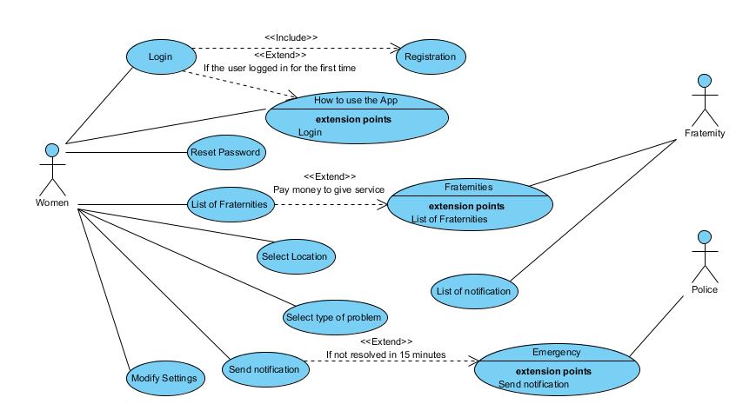
UML Diagram
Spandana Chava

Slide 15
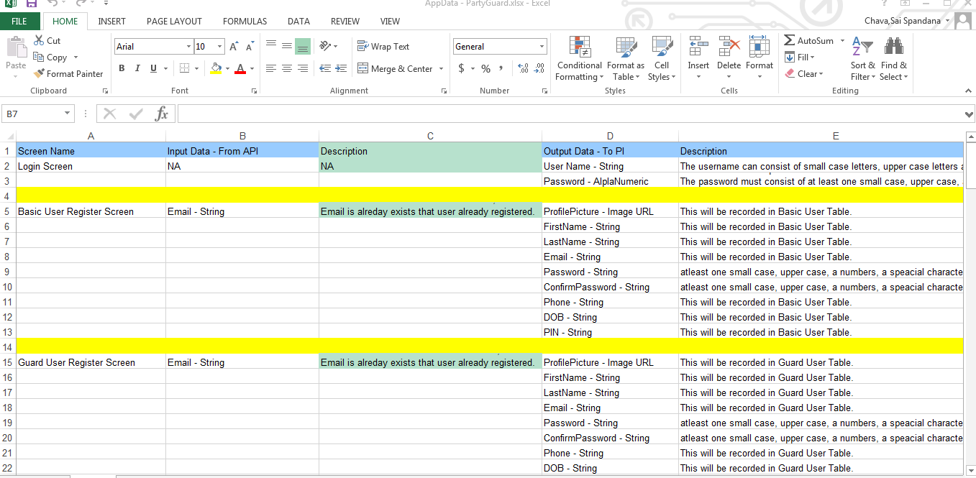
Project API Requirement
Spandana Chava

Slide 16
UI Design
Developers will be critical throughout the first phase of app development
We generally work with the developer to define your concept, storyboard, design the UI, prototype and then code your app
All apps are powered by event driven programming
Suprem Raju Manthena

Slide 17

App development starts with designing UI
Suprem Raju Manthena

Slide 18
(Contd..)
The UI demo will tell how you app will work – the interactions between the UI, the database, and the user that make it function
The prototype created will serve as a mockup of the app for the developers to get started on software plan for both front and bank ends
Suprem Raju Manthena

Slide 19

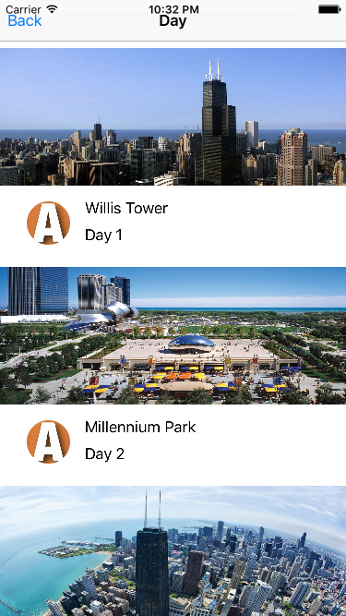
Example UI
Suprem Raju Manthena

Slide 20
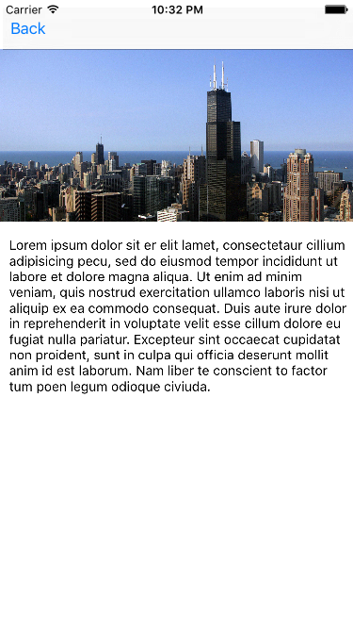
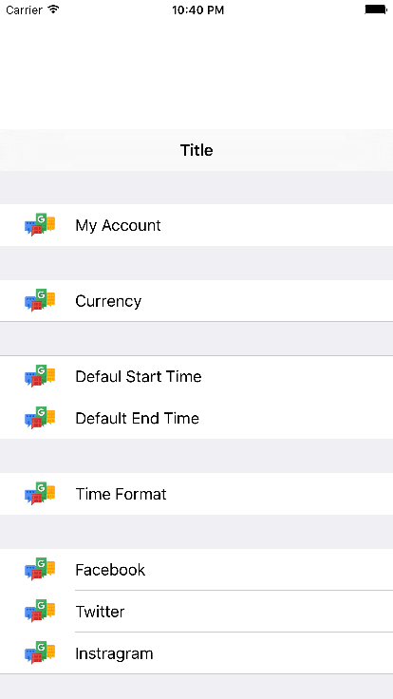
Example UI
Suprem Raju Manthena

Slide 21
REST Web services
Example of an excellent API that can be used to guide development
WEB API 2 Template created by default by ASP.NET Web API application
https://stripe.com/docs/api
Prasunjit Nayak

Slide 22
RESTful Resources & naming conventions
Fundamentally two types of resources:
1. Collection Resource
GET api/Account/ = Retrieves a list of account
POST api/Account/ = Creates a new Account
2. Instance Resource
GET api/values/5 = Retrieves a specific account
DELETE api/values/5 = Deletes values #5
Prasunjit Nayak

Slide 23
RESTful Resources and actions
how do you deal with relations?
GET api/UniversityModels/1/FraternityModels = Retrieves list of fraternities for university #1
POST api/UniversityModels/1/FraternityModels - Creates a new fraternity in university #12
Where do you define the relation?
As a standard the best practice is to define the relations for respective controller in its respective DB context file
Prasunjit Nayak

Slide 24
Authentication
Login:
Url: http://partyguardservices20160912122440.azurewebsites.net/token
Request type: Text(text/plain)
request data:
username=ashish@gmail.com&password=Hello_456&grant_type=password
Method: post
Status: 200 OK
Response:
{
"access_token": "I0E9QlwZwmuLX2WRCUjKGUzk1Mjm6- BPX7Dh43LAT00B_Kw3zmyA8PX3-PlspDc4F_
"token_type": "bearer",
"expires_in": 1209599,
"userName": "ashish@gmail.com",
".issued": "Thu, 29 Sep 2016 01:42:46 GMT",
".expires": "Thu, 13 Oct 2016 01:42:46 GMT“
}
Prasunjit Nayak

Slide 25
Authentication
Avoid sessions when possible Authenticate every request if necessary Stateless
Use Existing Protocol: Oauth 1.0a, Oauth2
Use Hash instead of Passwords
HTTP Authentication Schemes
Get User Info:
Url: http://partyguardservices20160912122440.azurewebsites.net/api/Account/UserInfo
Header: Authorization : Bearer <Access token>
request data:
Method: Get
Status: 200 OK
Response:
{
"Email": "ashish@gmail.com",
"HasRegistered": true,
"LoginProvider": null
}
Prasunjit Nayak

Slide 26
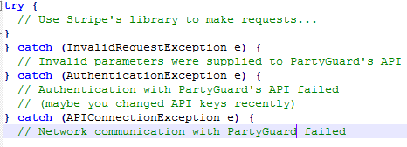
Handling Errors
api_connection_error : Failure to connect to PartyGuard’s API.
authentication_error : Failure to properly authenticate yourself in the request.
invalid_request_error: Invalid request errors arise when your request has invalid parameters.
Prasunjit Nayak

Slide 27
Miscellaneous
JSON only responses
Media-Type : application/json
camelCase for field names
account.givenName Not account.given_name
Versioning : http://partyguardservices20160912122440.azurewebsites.net/v1
Date/Time/Timestamp
Url: http://partyguardservices20160912122440.azurewebsites.net
Prasunjit Nayak

Slide 28
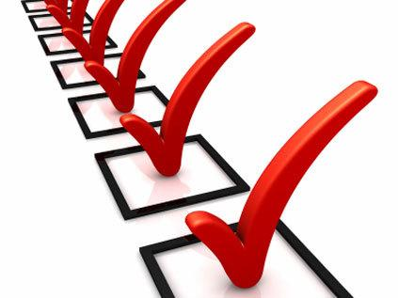

How do you keep making process until things become available?
List the requirements
Book hotel room
Show route map
Prepare itinerary
Save itinerary
Display all user trips
Prioritize
Prepare itinerary
Save itinerary
Display all user trips
Reserve hotel room
Provide route map coordinates
Krishna Kumar Painuly

Slide 29
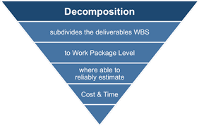
(contd..)
Create Work Breakdown Structure
Prepare itinerary
Get Place id from Google places API
Fetch activities of the place (e.g. : Chicago)
Prepare schedule for duration of travel
Identify dependencies
User Login –> User API (Authentication & Authorization)
Show Itinerary – Itinerary API -> Places, Wikipedia, google places API’s, etc
Save the itinerary –Itinerary API (Save)
Develop the High priority ones
App team – develop UI’s
Validate inputs
Krishna Kumar Painuly

Slide 30
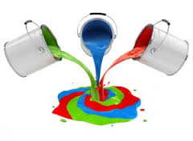
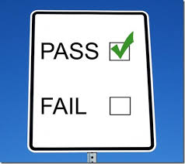
(contd..)
Integrate
Call APIs and process data
Test
Validate the processed data
Deliver
Release the project
Document the release
Krishna Kumar Painuly

Slide 31
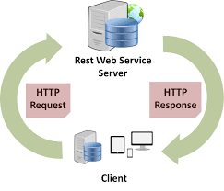
What do your front-end consumers of the services need to know about good design and practices?
Web service Type
REST or SOAP
Communication protocol
HTTP
HTTP Status Codes
200 – OK
404 – not found
500 – Internal Server Error
HTTP Verbs
Get, post, put, delete
Krishna Kumar Painuly

Slide 32
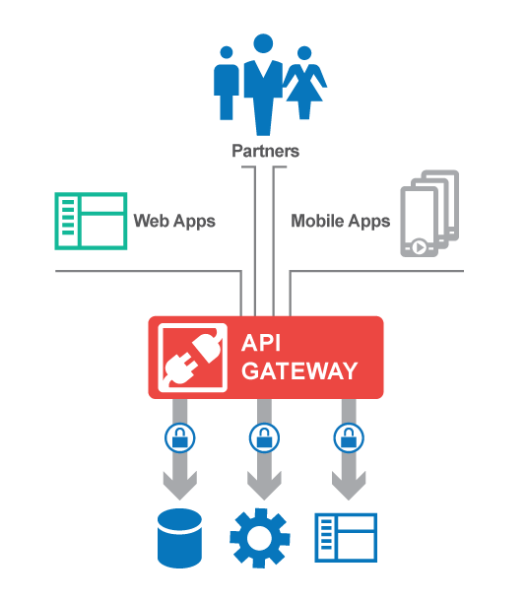
(contd..)
API Specifications
Format
Variable names
Data types
Error information
Send request
https://ec2dev.pplane.ca/city/ChIJdd4hrwug2EcRmSrV3Vo6llI
Krishna Kumar Painuly

Slide 33
(contd..)
Output Data
{
"results": [
{
"formatted_address": "Parliament Sq (Bridge St), City of Westminster, Greater London, S W1P, United Kingdom",
"geometry": {
"location": {
"lat": 51.50064517819402,
"lng": -0.1245725154876709
}
},
"name": "Elizabeth Tower (Big Ben)",
}
Krishna Kumar Painuly

Slide 34

How did we work together?
We worked together as a team by
Collaborating
Communicating
Respecting
Problem Solving
Working hard by meeting the deadlines
We are using Agile methodology for our project development
This method is helping us to focus on coding, testing often, and delivering functional bits of the application as soon as they're ready
Source: http://oproma.com/?page_id=2993
Rakshith Anand

Slide 35
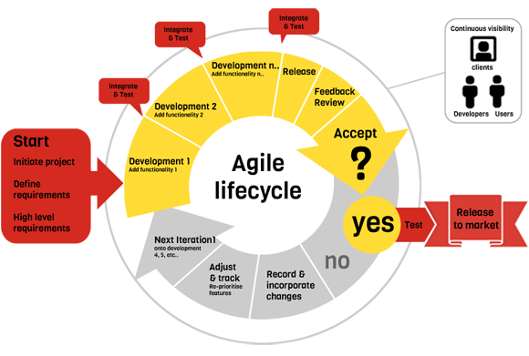
How did we work together? Cont..
Source: http://www.techmatr.com/project-management
Rakshith Anand

Slide 36
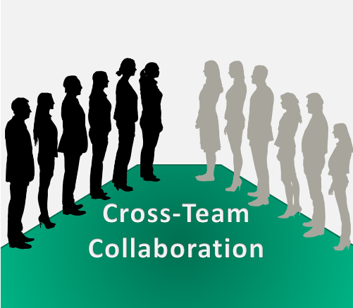
How did we work together? Cont..
We also worked with the services team as they help us in developing the API’s which we used them for implementing the functionality of our application
Point of contact
Weekly meetings
Social Networking
Source: http://3circlepartners.com/cross-team-collaboration/
Rakshith Anand

Slide 37
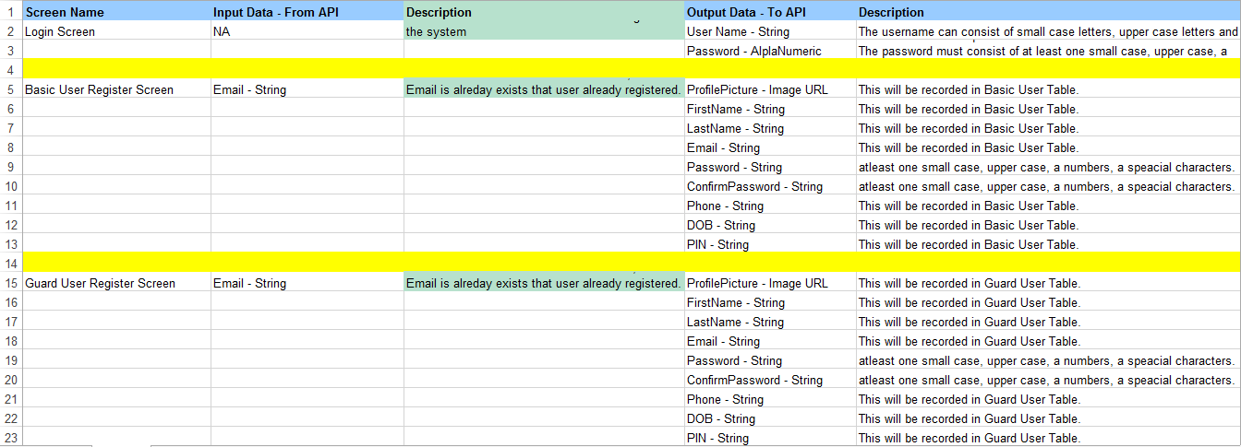
How did we work together? Cont..
Rakshith Anand

Slide 38
Bad Design
Paperplane Android application
Idlebrain Website
Vamshinath Nallamothu

Slide 39
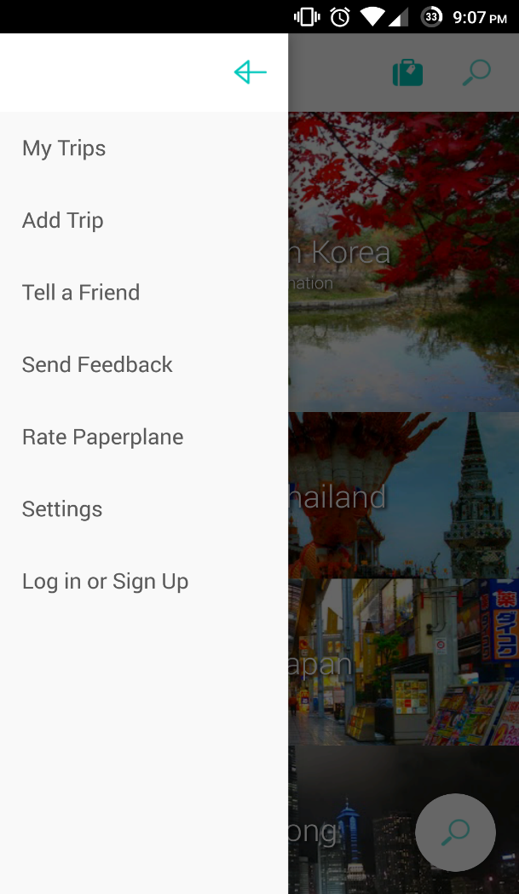
Login Problem
Vamshinath Nallamothu

Slide 40
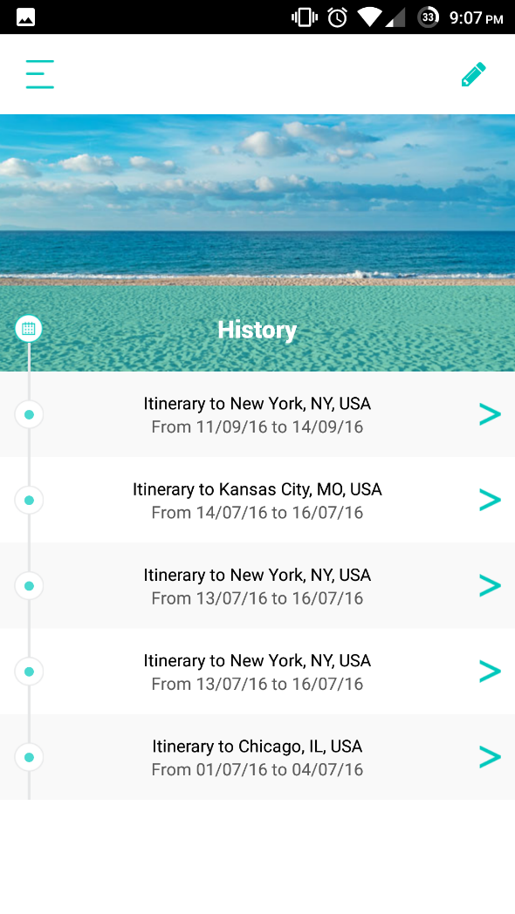
Itinerary
Vamshinath Nallamothu

Slide 41
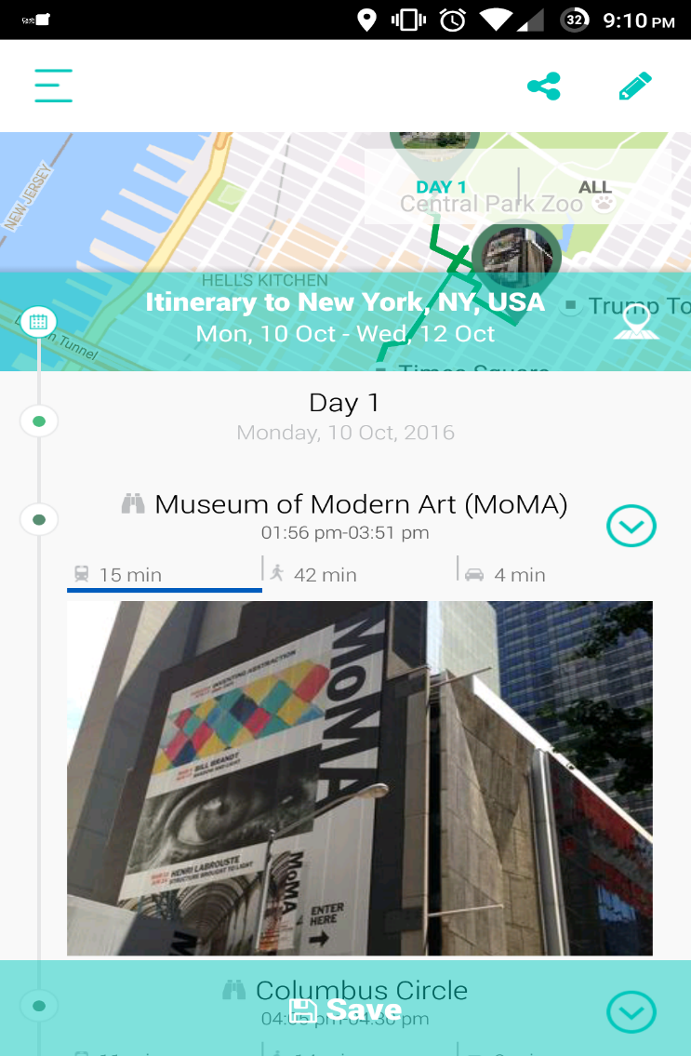
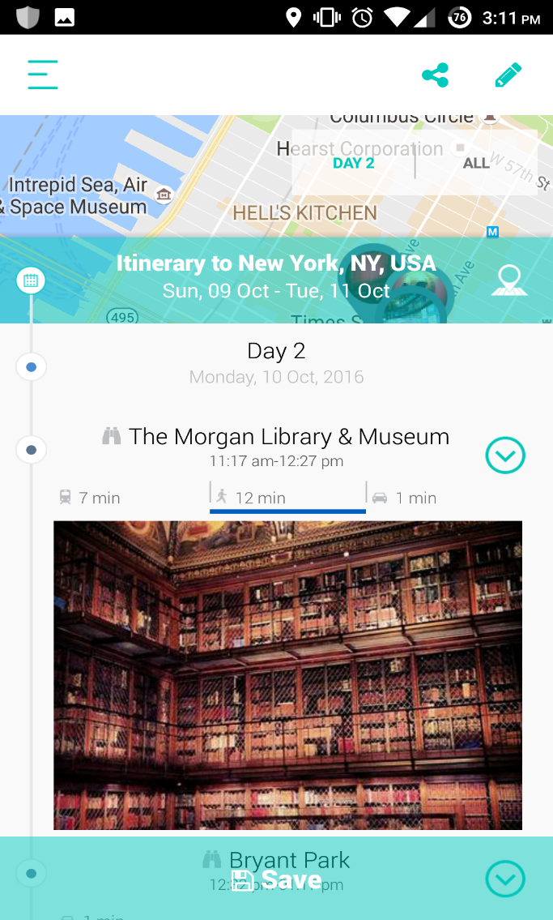
Services
Vamshinath Nallamothu

Slide 42
Conclusion

Slide 43
Thank you

